Slide 1
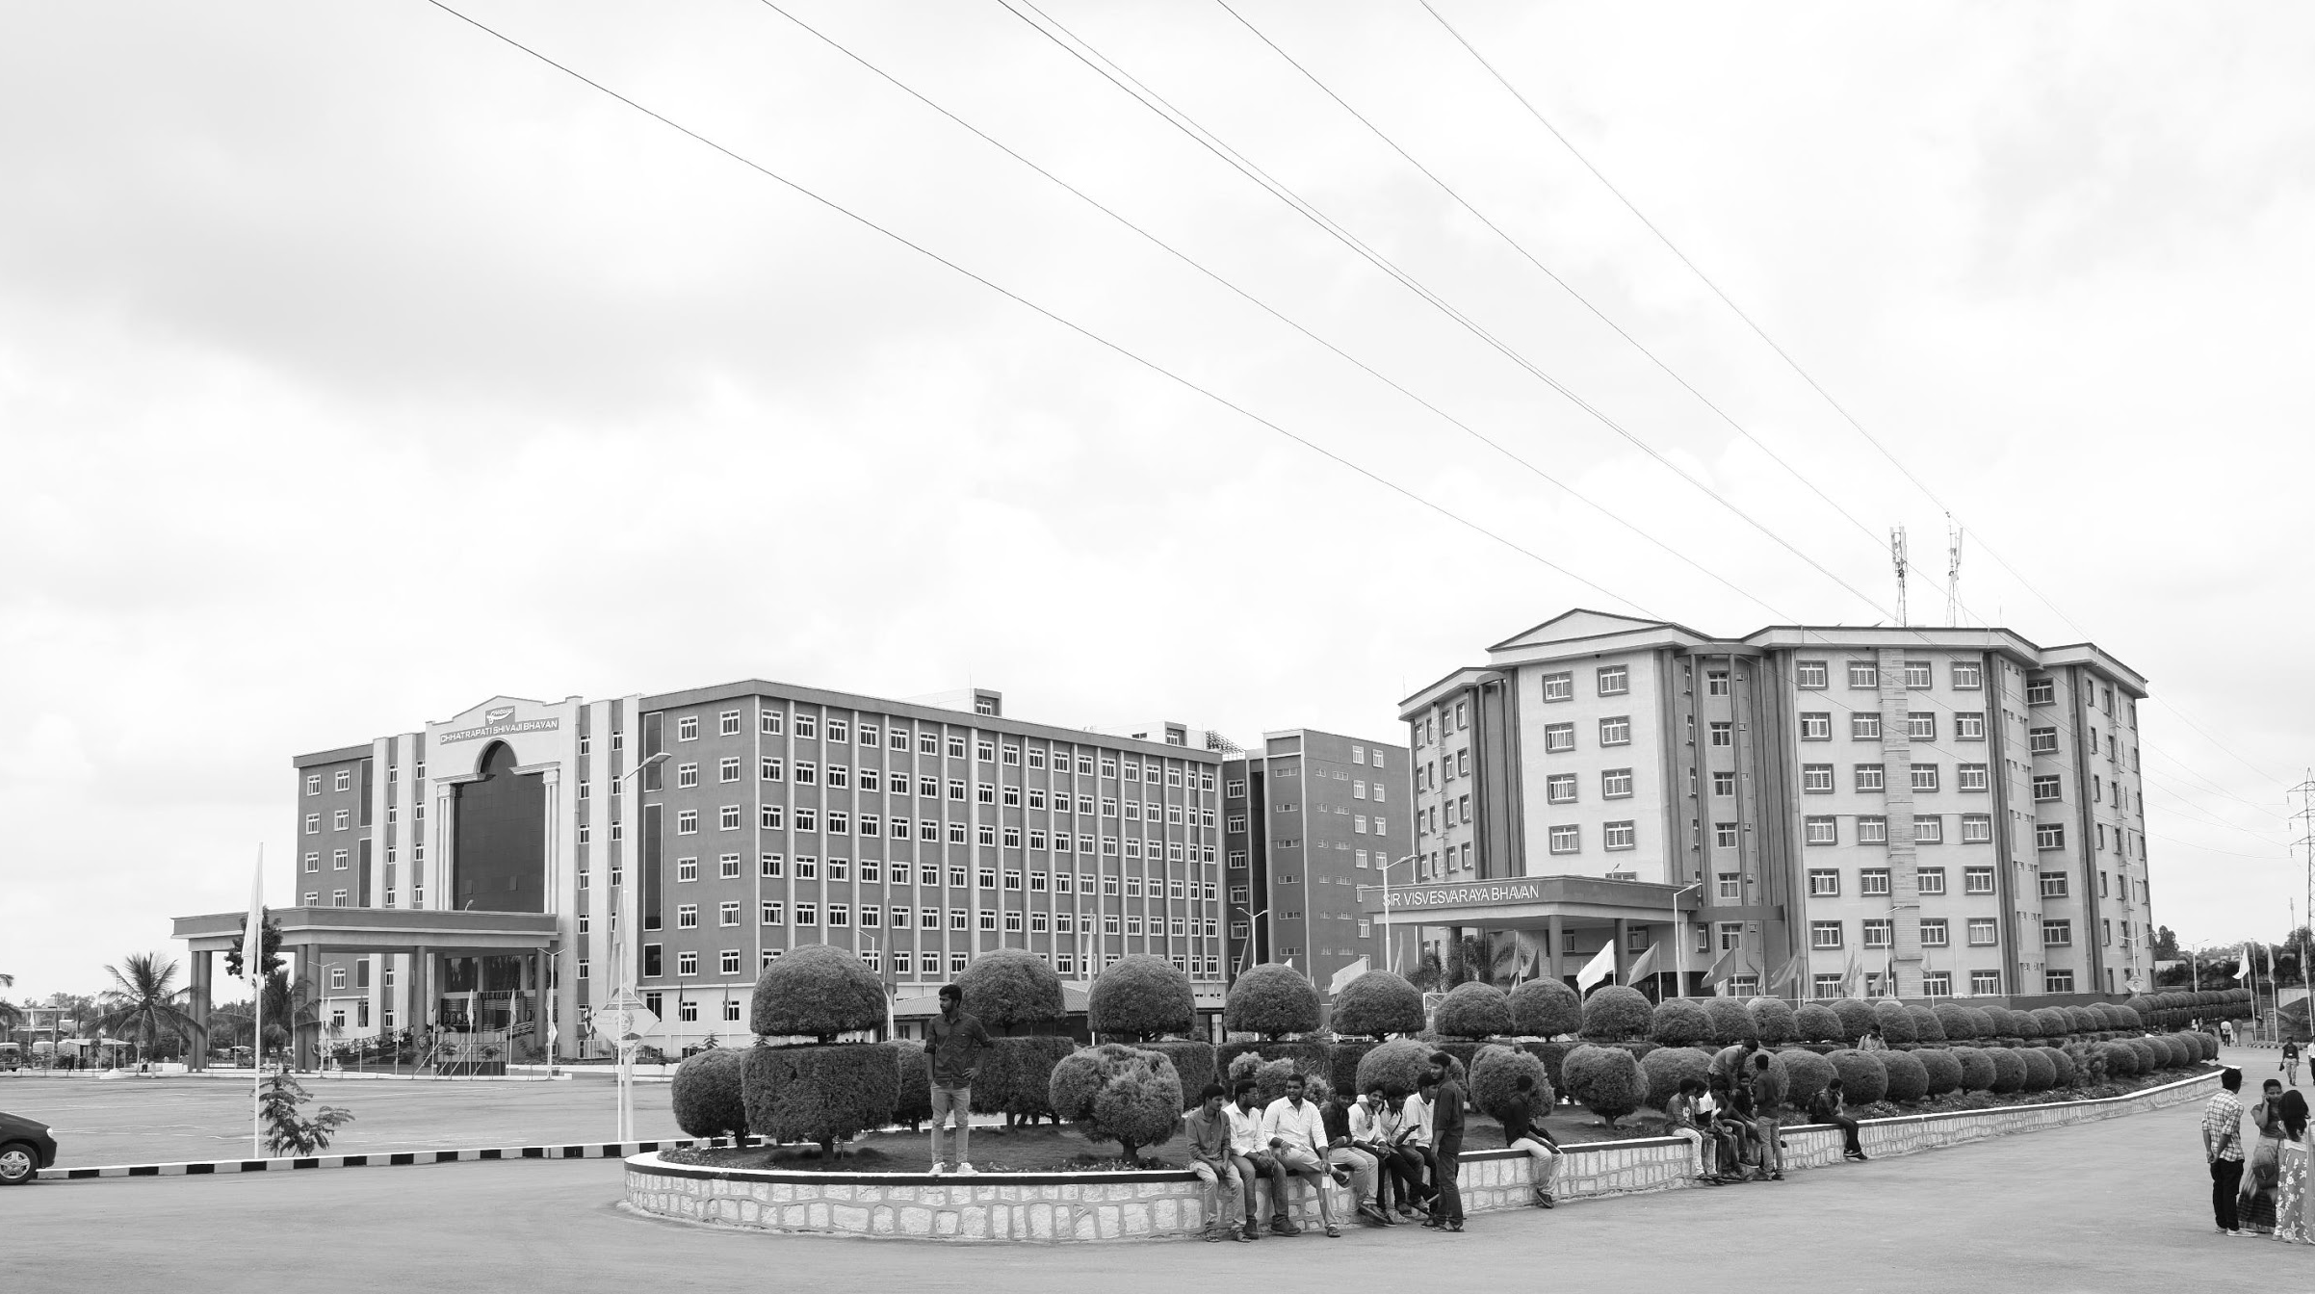

Modification on Conventional Visible and Infrared Image fusion methods for Real time Applications
Mid-Review - 3
Major Project
Project ID: A5
AY 2021-25
GITAM (Deemed-to-be) University
Project Team:
Netla Shanmuka Harshavardhan Reddy BU21EECE0100186
Battula Thanuja BU21EECE0100295
Siddavatam Mohammad Khwaja Moinuddin BU21EECE01381
Department of Electrical Electronics and Communication Engineering
Project Mentor:
Dr. Jeevan K M
Project In-charge:
Mr. Nithin Eswarappa
www.gitam.edu

Slide 2
Objective and Goals
Objective
To develop and optimize algorithms that improve the fusion of visible and infrared images, ensuring the preservation of critical information from both modalities in real-time applications.
To enhance the computational efficiency of conventional image fusion methods, enabling their deployment on resource-constrained devices without compromising performance.
To integrate the modified image fusion techniques seamlessly with existing real-time systems, facilitating their adoption in applications like surveillance, medical imaging, and remote sensing.
Main Goals
Multi-Resolution Details
Remote Sensing
Enhanced Visualization and Analysis
Additional Goals :
Real-time Processing
Accurate
Goals

Slide 3
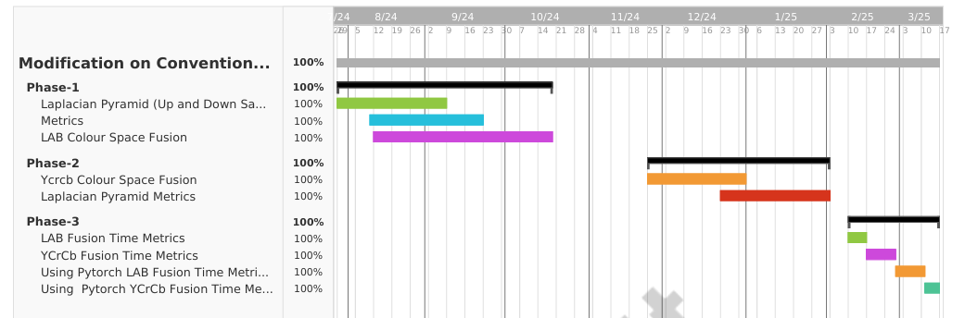
Project Plan

Slide 4
Literature Survey
Key Publications
S.No | Title | Autor | Published In | Objective
1 | A Colour-Focused Visible and Infrared Image Fusion Framework for Aiding Human Perception | Nithin Eswarappa, Shefali Waldekar, Jeevan K.M, Bikram Kumar Vivek and Koshy George | 2024 IEEE International Conference on Electronics, Computing and Communication Technologies (CONECCT) Date of Conference: 12-14 July 2024 Date Added to IEEE Xplore: 20 September 2024 | Image fusion methods are required when images from the same or different sensors are available. In several applications, photographs from a colour camera are often fused with thermal infrared (medium-wave or long-wave) images. This paper focuses on those applications (typically security and surveillance) wherein the fused images are used by a human operator who will, in turn, make critical decisions. This paper presents two frameworks for fusing colour and infrared images, one in the red-green-blue (RGB) colour space and the other in lightness-chroma-hue (LCH) colour space. We compare qualitatively and quantitatively the performance of five existing fusion methods that work best in this scenario. The study is carried out across two datasets. Quantitatively, four existing metrics are used to analyse the performance. In addition, this paper proposes a performance metric that appeals to human perception and measures how well colour, edge, and contrast information are transferred to the fused image.
2 | Infrared and visible image fusion based on domain transform filtering and sparse representation | Xilai Li , Haishu Tan, Fuqiang Zhou, Gao Wang, Xiaosong Li | June 2023, Infrared Physics & Technology Volume 131, 104701 | This paper presents a new method for combining infrared and visible images to provide clearer and more detailed images of complex scenes. The process involves breaking the images into simpler base layers and detailed layers. The detailed layers are merged using a technique that enhances important features. A special filter (DTF) is used to combine the base layers while keeping key structures and edges intact. This approach helps retain important details from both images. Tests show that the method produces better results than other existing methods, both visually and in terms of measurable quality.

Slide 5
Key Resources
S.No | Title | Author | Published In | Objective
1 | Image Fusion technique using Multi-resolution singular Value decomposition | V.P.S. Naidu | 5, September 2011, Defence Science Journal, Vol. 61, pp. 479-484 | A novel image fusion technique based on multi-resolution singular value decomposition (MSVD) has been presented and evaluated. The performance of this algorithm is compared with that of well known image fusion technique using wavelets. It is observed that image fusion by MSVD perform almost similar to that of wavelets. It is computationally very simple and it could be well suited for real time applications. Moreover, MSVD does not have a fixed set of basis vectors like FFT, DCT and wavelet etc. and its basis vectors depend on the data set.
Existing Implementations
[LP] “The Laplacian Pyramid as a Compact Image Code”, Burt, 1983
[MST-LP]”Infrared and visible image fusion based on target-enhanced multiscale transform decomposition”, 2019

Slide 6
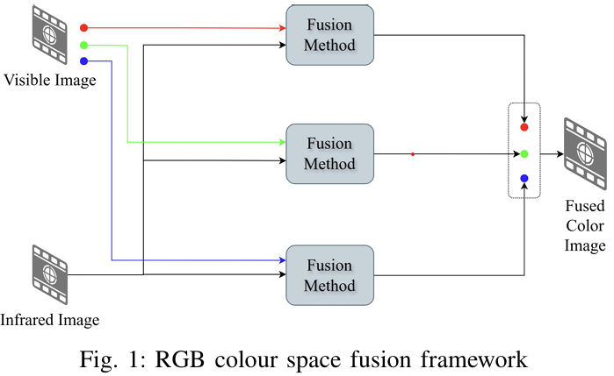
Architecture
Structural Diagram
Block Diagram/Pin Diagram
Resource - https://www.lucidchart.com/pages/examples/uml_diagram_tool
Behaviour Diagram
Flow chart/ State machine
Resource - https://www.lucidchart.com/pages/examples/uml_diagram_tool

Slide 7
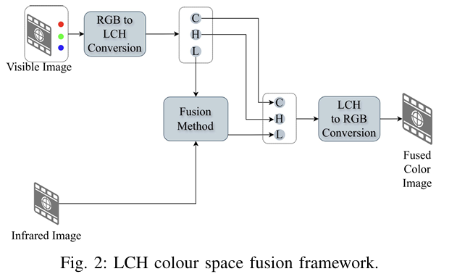

Slide 8
Use Cases & Testing
Use Cases
Surveillance and Security: Use fused visible and infrared images for enhanced security surveillance, especially in low-light or adverse weather conditions and and rescue missions, particularly in challenging environments like smoke-filled or dark areas.
Remote Sensing: Employ image fusion for obstacle detection and navigation in autonomous vehicles, ensuring better performance in diverse lighting conditions.
Medical Imaging: Integrate visible and infrared imaging for medical diagnostics, providing better detail and contrast in images for more accurate diagnoses.
Test Cases
Performance in Low Light Conditions: Test the image fusion method's effectiveness in environments with minimal visible light.
Real-Time Processing Speed: Measure the time taken for the fusion process to ensure it meets real-time application requirements.
Accuracy of Object Detection: Evaluate the accuracy of object detection algorithms using fused images compared to individual visible and infrared images.

Slide 9
Implementation and Results – Iteration 1
Iteration 1 : Results
#Fusion
import cv2 # Import OpenCV for image processing
import numpy as np # Import NumPy for handling arrays
import matplotlib.pyplot as plt # For displaying images using Matplotlib
# Paths to the images
ir_image_path = 'D:\\PROJECT\\M3FD_Fusion(1)\\Ir\\00000.png'
visible_image_path = 'D:\\PROJECT\\M3FD_Fusion(1)\\Vis\\00000(1).png'
# Load the infrared (IR) image and the visible image
ir_image = cv2.imread(ir_image_path, cv2.IMREAD_GRAYSCALE) # Load IR image in grayscale
visible_image = cv2.imread(visible_image_path, cv2.IMREAD_COLOR) # Load visible image in RGB
# Check if both images are loaded successfully
if ir_image is None:
print(f"Error: IR image not found or unable to load from {ir_image_path}")
else:
print(f"IR image loaded successfully from {ir_image_path}")
if visible_image is None:
print(f"Error: Visible image not found or unable to load from {visible_image_path}")
else:
print(f"Visible image loaded successfully from {visible_image_path}")
# Proceed only if both images are loaded successfully
if ir_image is not None and visible_image is not None:
# Resize IR image to match visible image dimensions
ir_image_resized = cv2.resize(ir_image, (visible_image.shape[1], visible_image.shape[0]))
# Convert the IR image to a 3-channel image by duplicating the single channel
ir_image_3channel = cv2.cvtColor(ir_image_resized, cv2.COLOR_GRAY2BGR)
# Perform a simple fusion by averaging the pixel values of the IR and visible images
fused_image = cv2.addWeighted(ir_image_3channel, 0.5, visible_image, 0.5, 0) # 0.5, 0.5 are weights for the images
cv2.imwrite('fused_image.jpg', fused_image)
# Display the images using Matplotlib
plt.figure(figsize=(15, 5))
plt.subplot(1, 3, 1)
plt.title('Infrared Image')
plt.imshow(ir_image, cmap='gray')
plt.subplot(1, 3, 2)
plt.title('Visible Image')
plt.imshow(cv2.cvtColor(visible_image, cv2.COLOR_BGR2RGB))
plt.subplot(1, 3, 3)
plt.title('Fused Image')
plt.imshow(cv2.cvtColor(fused_image, cv2.COLOR_BGR2RGB))
plt.show()

Slide 10
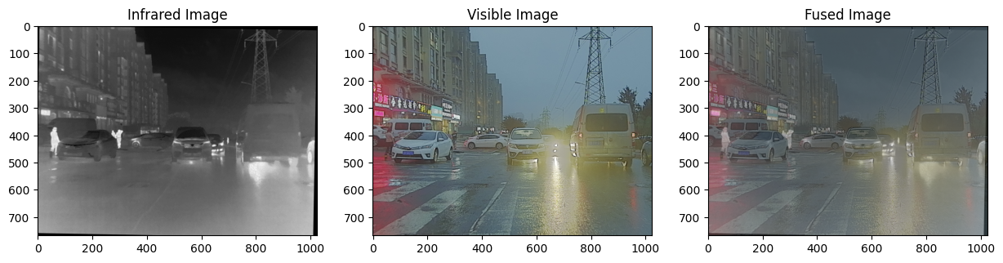
Results

Slide 11
Implementation and Results – Iteration 2
import cv2
import numpy as np
import matplotlib.pyplot as plt
# Load the infrared (IR) image and the RGB image
ir_image_path = 'D:\\PROJECT\\M3FD_Fusion(1)\\IR\\00000.png'
rgb_image_path = 'D:\\PROJECT\\M3FD_Fusion(1)\\Vis\\00000(1).png'
# Load images
ir_image = cv2.imread(ir_image_path, cv2.IMREAD_GRAYSCALE)
rgb_image = cv2.imread(rgb_image_path, cv2.IMREAD_COLOR)
if ir_image is None:
print(f"Error: Infrared image not found or unable to load from {ir_image_path}")
if rgb_image is None:
print(f"Error: RGB image not found or unable to load from {rgb_image_path}")
if ir_image is not None and rgb_image is not None:
# Convert the RGB image to LAB color space
lab_image = cv2.cvtColor(rgb_image, cv2.COLOR_BGR2LAB)
# Resize the infrared image to match the L channel size
ir_image_resized = cv2.resize(ir_image, (lab_image.shape[1], lab_image.shape[0]))
# Split the LAB image into its channels
L, A, B = cv2.split(lab_image)

Slide 12
# Fuse the L channel with the infrared image using simple averaging
fused_L = cv2.addWeighted(L, 0.5, ir_image_resized, 0.5, 0)
# Merge the fused L channel back with the original A and B channels
fused_lab_image = cv2.merge((fused_L, A, B))
# Convert the fused LAB image back to RGB color space for visualization
fused_rgb_image = cv2.cvtColor(fused_lab_image, cv2.COLOR_LAB2BGR)
# Display the images using matplotlib
plt.figure(figsize=(15, 5))
plt.subplot(1, 3, 1)
plt.title('Infrared Image')
plt.imshow(ir_image, cmap='gray')
plt.axis('off')
plt.subplot(1, 3, 2)
plt.title('LAB Image')
plt.imshow(cv2.cvtColor(lab_image, cv2.COLOR_LAB2RGB))
plt.axis('off')
plt.subplot(1, 3, 3)
plt.title('Fused Image')
plt.imshow(cv2.cvtColor(fused_rgb_image, cv2.COLOR_BGR2RGB))
plt.axis('off')
plt.show()
fused_image_path = 'D:\\PROJECT\\M3FD_Fusion(1)\\fused_lab_ir_image.png'
cv2.imwrite(fused_image_path, fused_rgb_image)

Slide 13
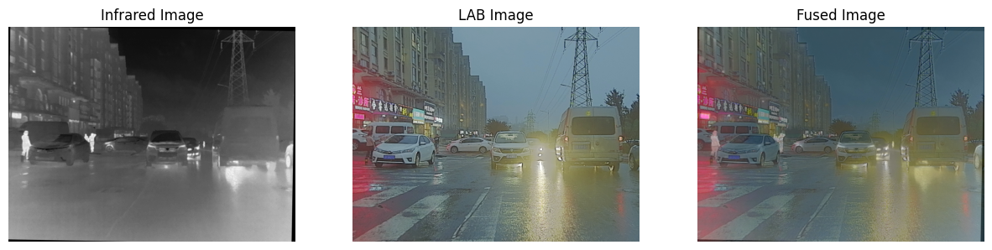
Results

Slide 14
Implementation and Results – Iteration 3
#YCbCr Fusion
import cv2
import numpy as np
import matplotlib.pyplot as plt
# Load the infrared (IR) image and the RGB image
ir_image_path = 'D:\\PROJECT\\M3FD_Fusion(1)\\IR\\00000.png'
rgb_image_path = 'D:\\PROJECT\\M3FD_Fusion(1)\\Vis\\00000(1).png'
ir_image = cv2.imread(ir_image_path, cv2.IMREAD_GRAYSCALE)
rgb_image = cv2.imread(rgb_image_path, cv2.IMREAD_COLOR)
# Check if images are loaded successfully
if ir_image is None:
print(f"Error: Infrared image not found or unable to load from {ir_image_path}")
if rgb_image is None:
print(f"Error: RGB image not found or unable to load from {rgb_image_path}")
if ir_image is not None and rgb_image is not None:
# Convert the RGB image to YCbCr color space
ycbcr_image = cv2.cvtColor(rgb_image, cv2.COLOR_BGR2YCrCb)
# Resize the infrared image to match the Y channel size
ir_image_resized = cv2.resize(ir_image, (ycbcr_image.shape[1], ycbcr_image.shape[0]))
# Split the YCbCr image into its channels
Y, Cr, Cb = cv2.split(ycbcr_image)
# Fuse the Y channel with the infrared image using simple averaging
fused_Y = cv2.addWeighted(Y, 0.5, ir_image_resized, 0.5, 0)
# Merge the fused Y channel back with the original Cr and Cb channels
fused_ycbcr_image = cv2.merge((fused_Y, Cr, Cb))
# Convert the fused YCbCr image back to RGB color space for visualization
fused_rgb_image = cv2.cvtColor(fused_ycbcr_image, cv2.COLOR_YCrCb2BGR)
# Display the images using matplotlib
plt.figure(figsize=(15, 5))
plt.subplot(1, 3, 1)
plt.title('Infrared Image')
plt.imshow(ir_image, cmap='gray')
plt.axis('off')
plt.subplot(1, 3, 2)
plt.title('YCbCr Image')
plt.imshow(ycbcr_image)
plt.axis('off')
plt.subplot(1, 3, 3)
plt.title('Fused Image')
plt.imshow(cv2.cvtColor(fused_rgb_image, cv2.COLOR_BGR2RGB))
plt.axis('off')
plt.show()
fused_image_path = 'D:\\PROJECT\\M3FD_Fusion(1)\\fused_ycbcr_ir_image.png' # Adjust the path to save your fused image
cv2.imwrite(fused_image_path, fused_rgb_image)

Slide 15
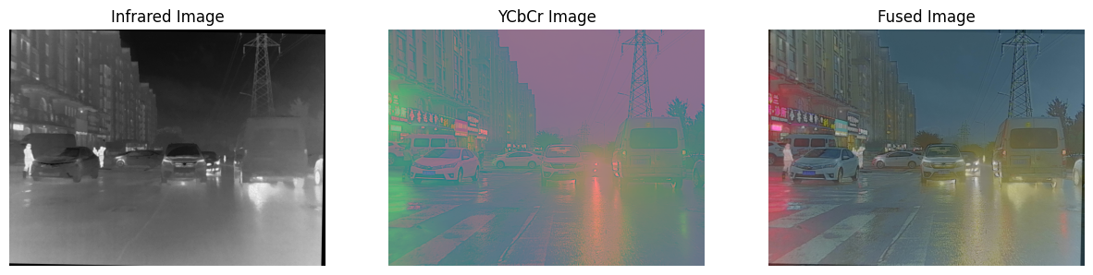
Results

Slide 16
Implementation – Iteration 4
import cv2
import numpy as np
from skimage.metrics import structural_similarity as ssim, peak_signal_noise_ratio as psnr
def calculate_entropy(image):
histogram, _ = np.histogram(image, bins=256, range=(0, 256))
histogram = histogram / np.sum(histogram)
entropy = -np.sum(histogram * np.log2(histogram + 1e-10))
return entropy
def calculate_mutual_information(img1, img2):
hist_2d, _, _ = np.histogram2d(img1.ravel(), img2.ravel(), bins=256)
hist_2d /= hist_2d.sum()
mi = np.sum(hist_2d * np.log2(hist_2d / (hist_2d.sum(axis=0) * hist_2d.sum(axis=1)[:, None] + 1e-10) + 1e-10))
return mi
def calculate_average_gradient(image):
grad_x = cv2.Sobel(image, cv2.CV_64F, 1, 0, ksize=3)
grad_y = cv2.Sobel(image, cv2.CV_64F, 0, 1, ksize=3)
return np.sqrt(grad_x*2 + grad_y*2).mean()
def calculate_standard_deviation(image):
return np.std(image)
def fuse_images_and_evaluate(ir_image_path, visible_image_path):
# Load images
ir_image = cv2.imread(ir_image_path, cv2.IMREAD_GRAYSCALE)
visible_image = cv2.imread(visible_image_path, cv2.IMREAD_COLOR)
# Resize and convert IR to 3-channel
ir_resized = cv2.resize(ir_image, (visible_image.shape[1], visible_image.shape[0]))
ir_image_3channel = cv2.cvtColor(ir_resized, cv2.COLOR_GRAY2BGR)
# Perform image fusion
fused_image = cv2.addWeighted(ir_image_3channel, 0.5, visible_image, 0.5, 0)
# Convert fused image to grayscale for evaluation
fused_gray = cv2.cvtColor(fused_image, cv2.COLOR_BGR2GRAY)
# Evaluate metrics
print(f"Entropy: {calculate_entropy(fused_gray):.4f}")
print(f"Mutual Information: {calculate_mutual_information(ir_image, fused_gray) + calculate_mutual_information(cv2.cvtColor(visible_image, cv2.COLOR_BGR2GRAY), fused_gray):.4f}")
print(f"PSNR: {psnr(cv2.cvtColor(visible_image, cv2.COLOR_BGR2GRAY), fused_gray):.4f}")
print(f"SSIM: {ssim(cv2.cvtColor(visible_image, cv2.COLOR_BGR2GRAY), fused_gray):.4f}")
print(f"Average Gradient: {calculate_average_gradient(fused_gray):.4f}")
print(f"Standard Deviation: {calculate_standard_deviation(fused_gray):.4f}")
# Example usage
ir_image_path = 'D:\\PROJECT\\M3FD_Fusion(1)\\Ir\\00000.png'
visible_image_path = 'D:\\PROJECT\\M3FD_Fusion(1)\\Vis\\00000(1).png'
fuse_images_and_evaluate(ir_image_path, visible_image_path)

Slide 17
Implementation – Iteration 5
import cv2 # Import OpenCV for image processing
import numpy as np
import SSIM_PIL # Import NumPy for handling arrays
# For displaying images in Colab
def calculate_psnr(img1, img2):
mse = np.mean((img1 - img2) ** 2)
if mse == 0:
return float('inf')
max_pixel = 255.0
psnr = 20 * np.log10(max_pixel / np.sqrt(mse))
return psnr
# Load the infrared (IR) image and the visible image
ir_image = cv2.imread('D:\\PROJECT\\01.png', cv2.IMREAD_GRAYSCALE) # Load IR image in grayscale
visible_image = cv2.imread('D:\\PROJECT\\01(1).png', cv2.IMREAD_GRAYSCALE) # Load visible image in grayscale
# Perform a simple fusion by averaging the pixel values of the IR and visible images
fused_image = cv2.addWeighted(ir_image, 0.5, visible_image, 0.5, 0) # 0.5, 0.5 are weights for the images
# Calculate PSNR between IR and Fused, and Visible and Fused
psnr_ir_fused = calculate_psnr(ir_image, fused_image)
psnr_visible_fused = calculate_psnr(visible_image, fused_image)
# Display the results
print(f"PSNR (IR, Fused): {psnr_ir_fused:.2f} dB")
print(f"PSNR (Visible, Fused): {psnr_visible_fused:.2f} dB")

Slide 18
Results For Iteration 4 and 5
Entropy: 6.4368
Mutual Information: 2.1647
PSNR: 17.7402
SSIM: 0.8378
Average Gradient: 30.5417
Standard Deviation: 23.2369
PSNR (IR, Fused): 28.28 dB
PSNR (Visible, Fused): 28.18 dB

Slide 19
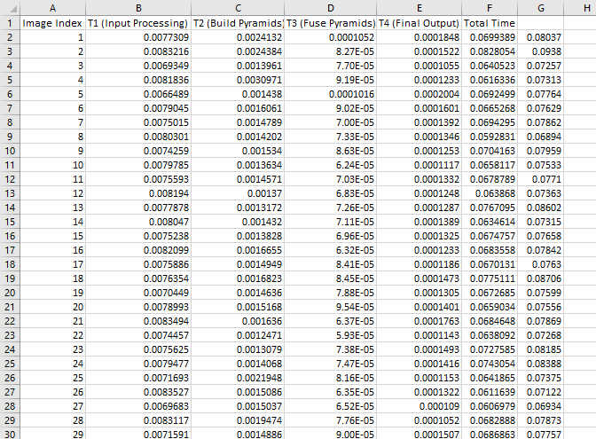
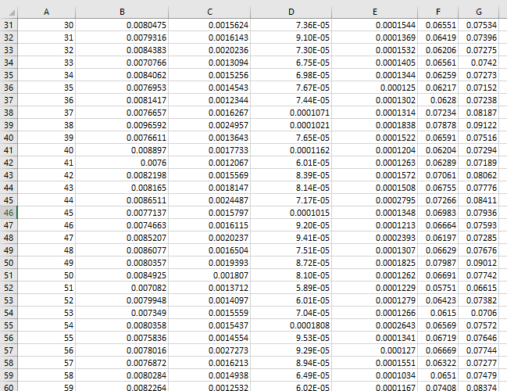
Fusion Time Metrics YCrCb Using Pytorch (GPU)

Slide 20
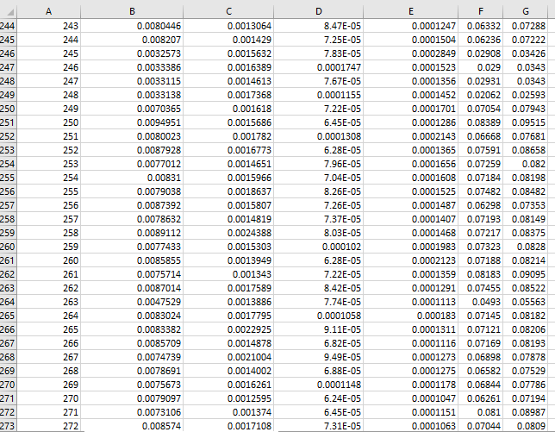
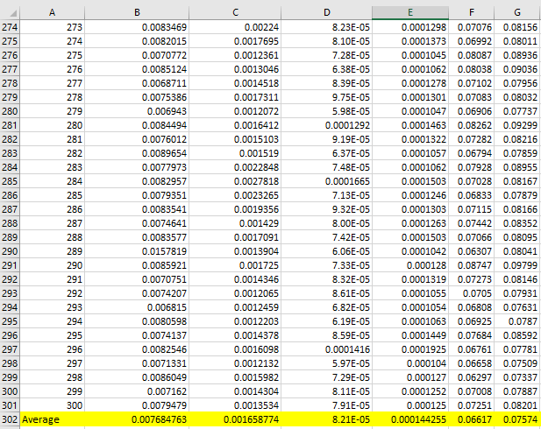
Continue..

Slide 21
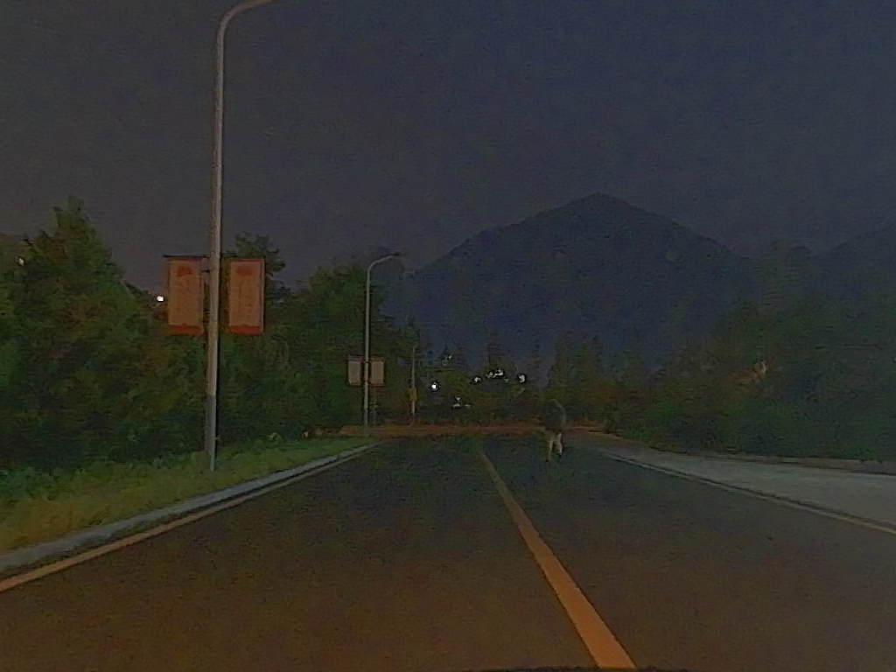
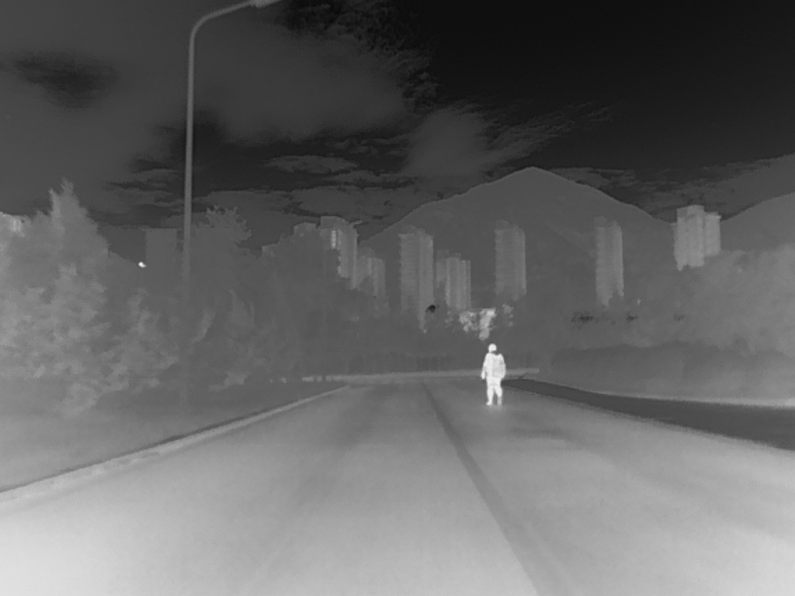
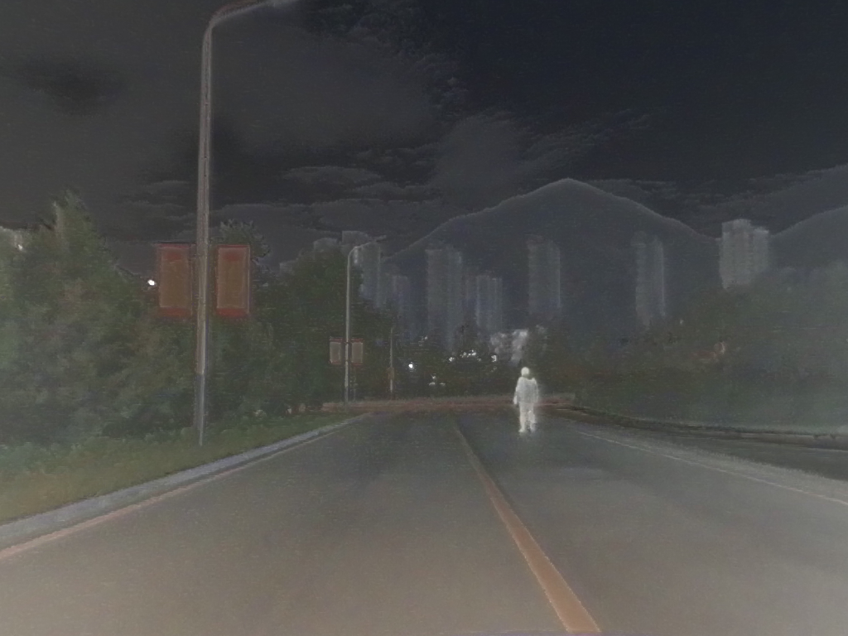
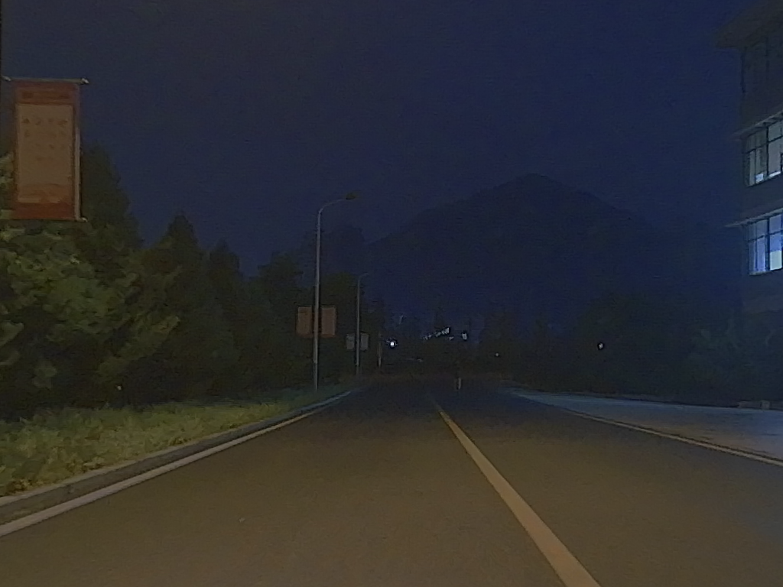
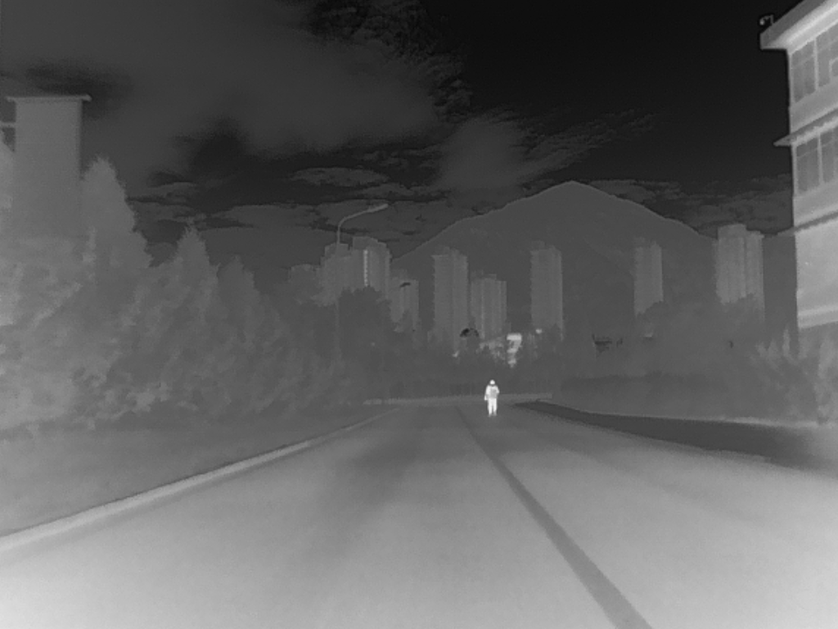
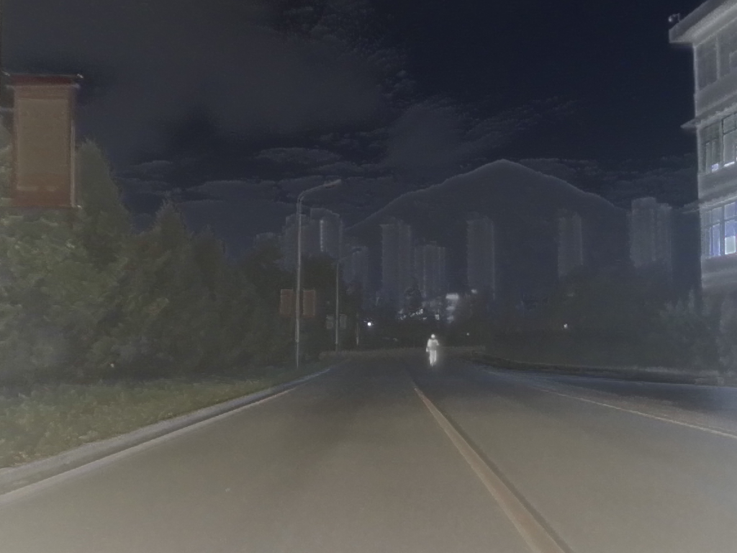
Visible Images
Infrared Images
Fused Images

Slide 22
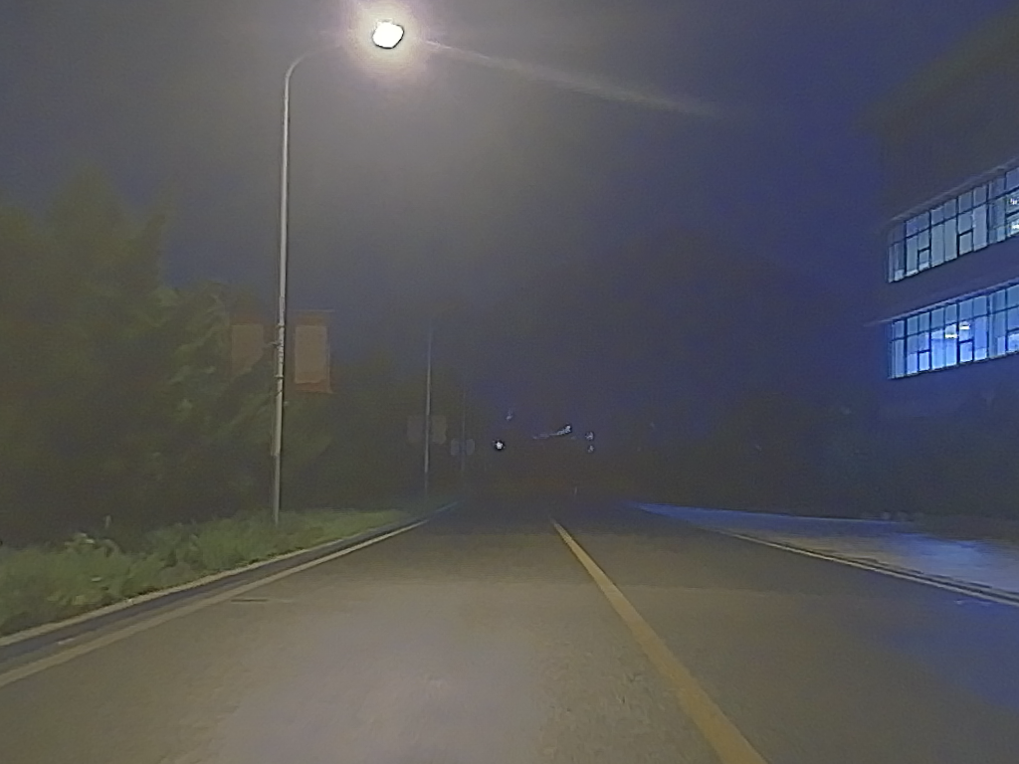
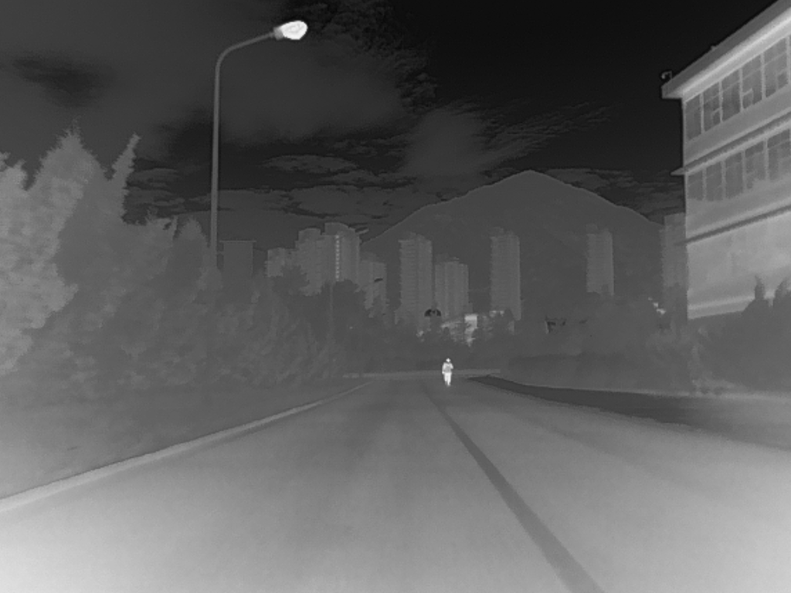
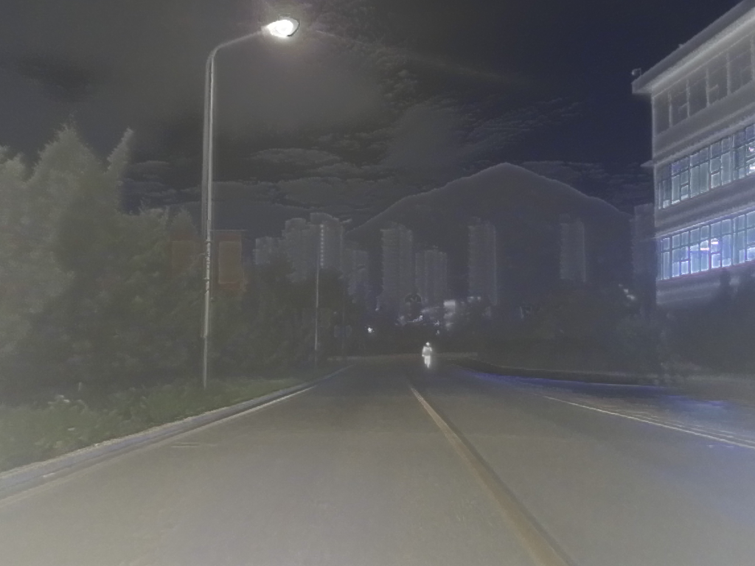
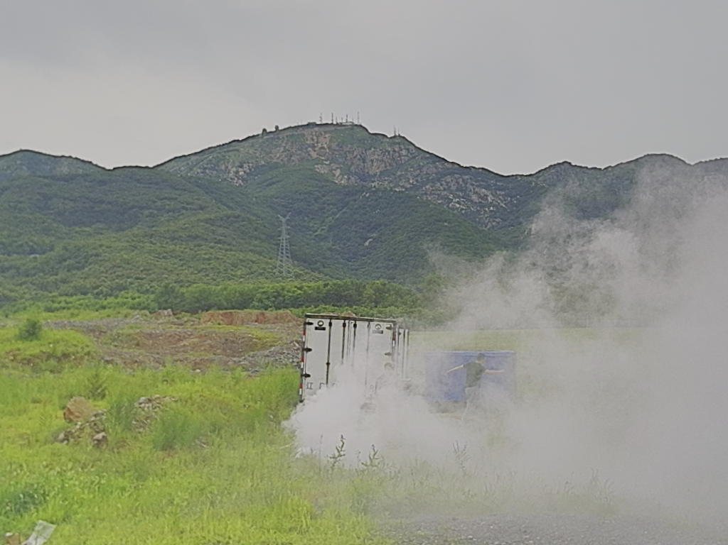
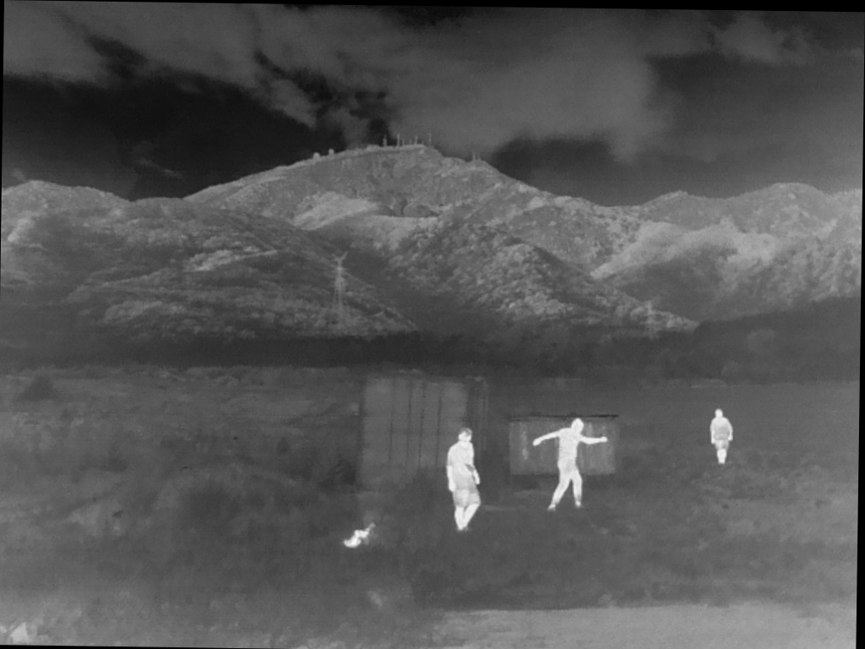
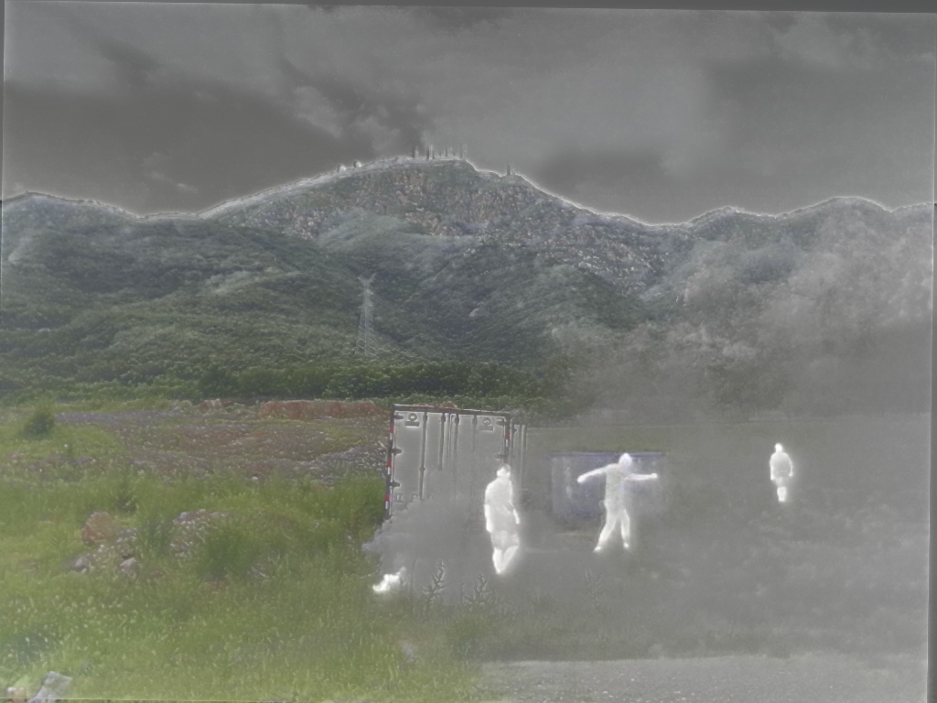

Slide 23
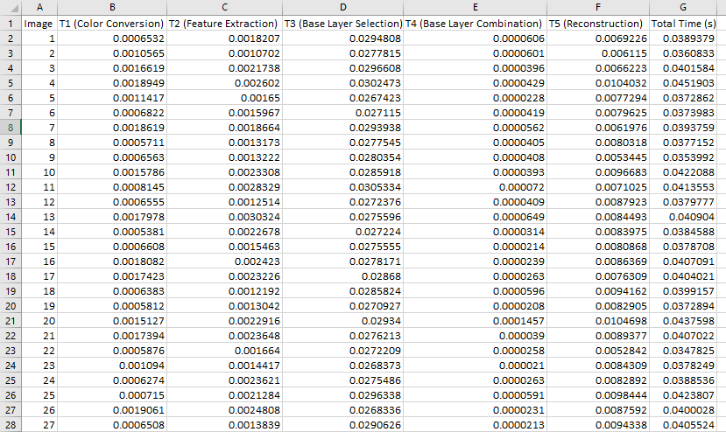
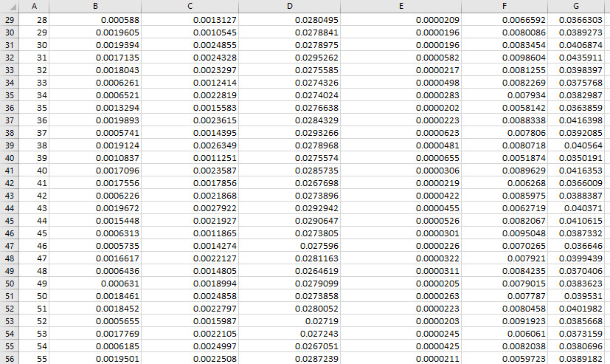
YCrCb Fusion Time Metrics (CPU)

Slide 24
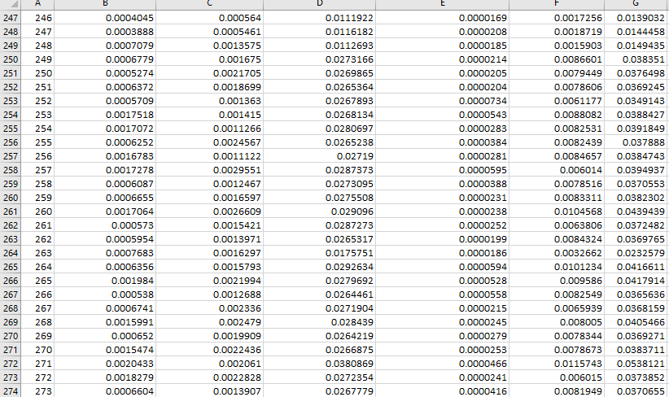
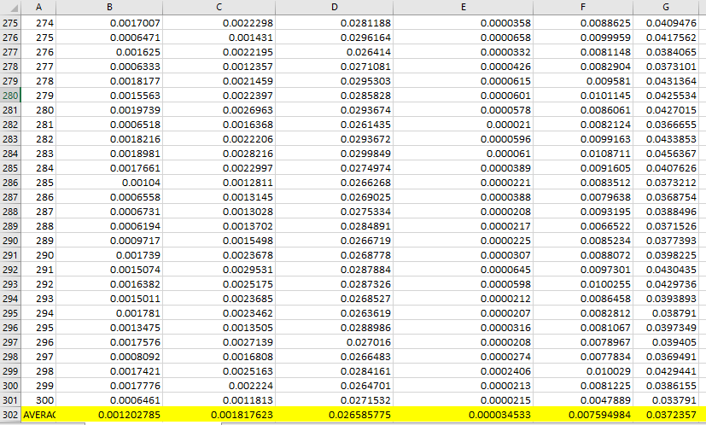
Continue..

Slide 25
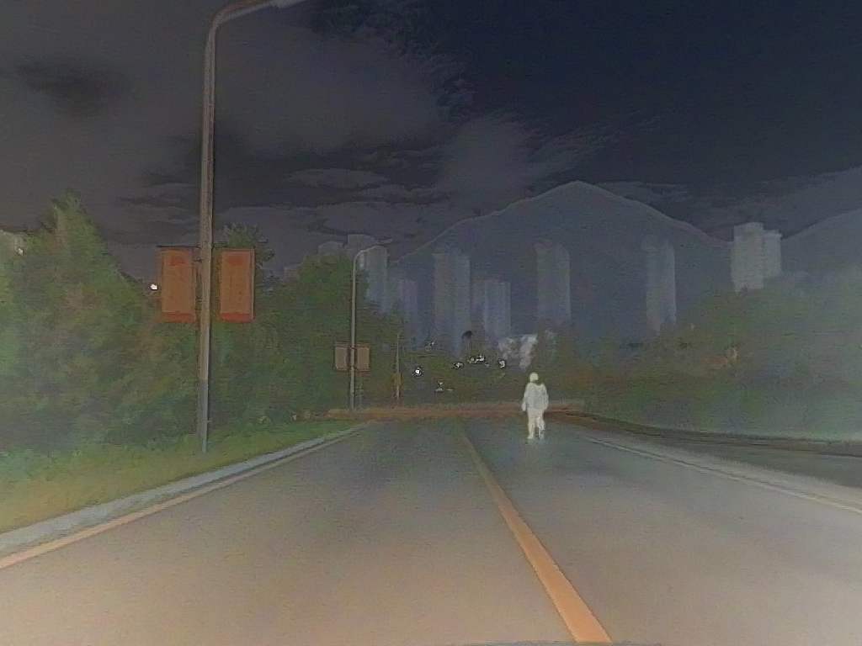
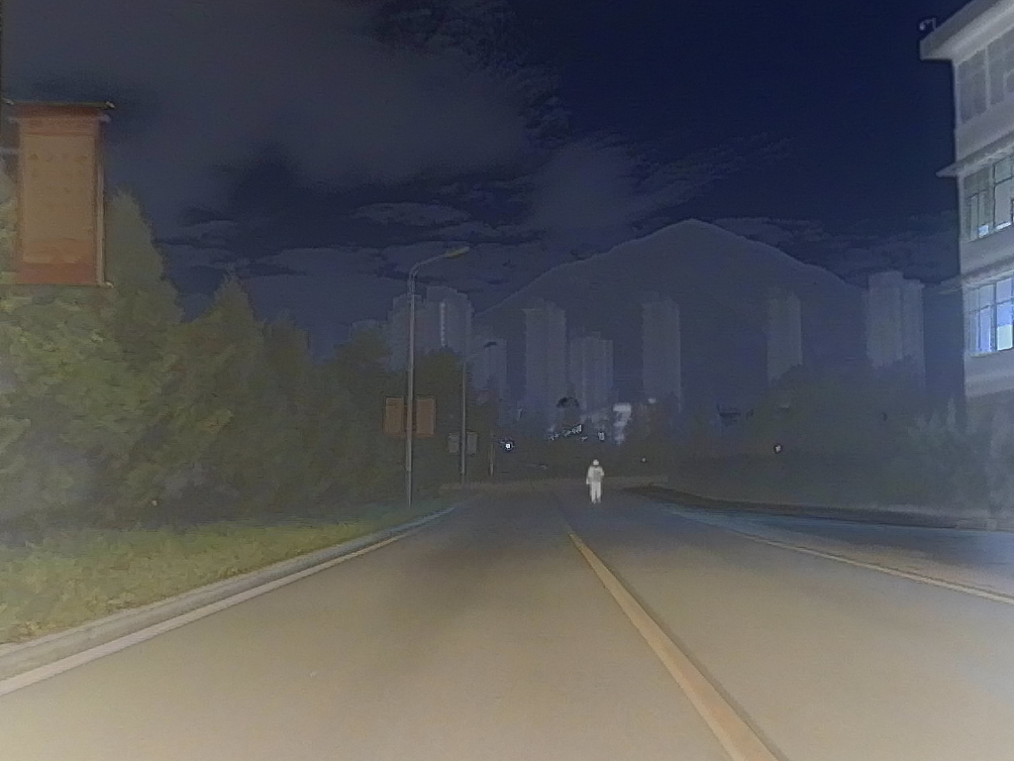
Visible Images
Infrared Images
Fused Images

Slide 26
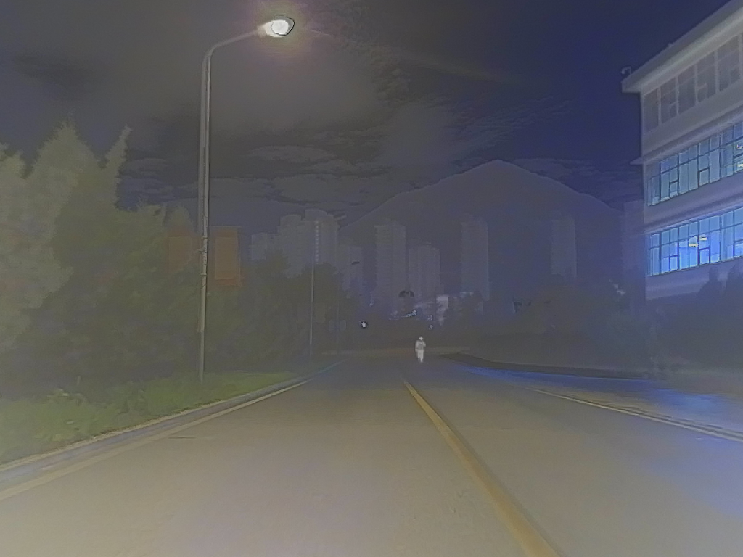
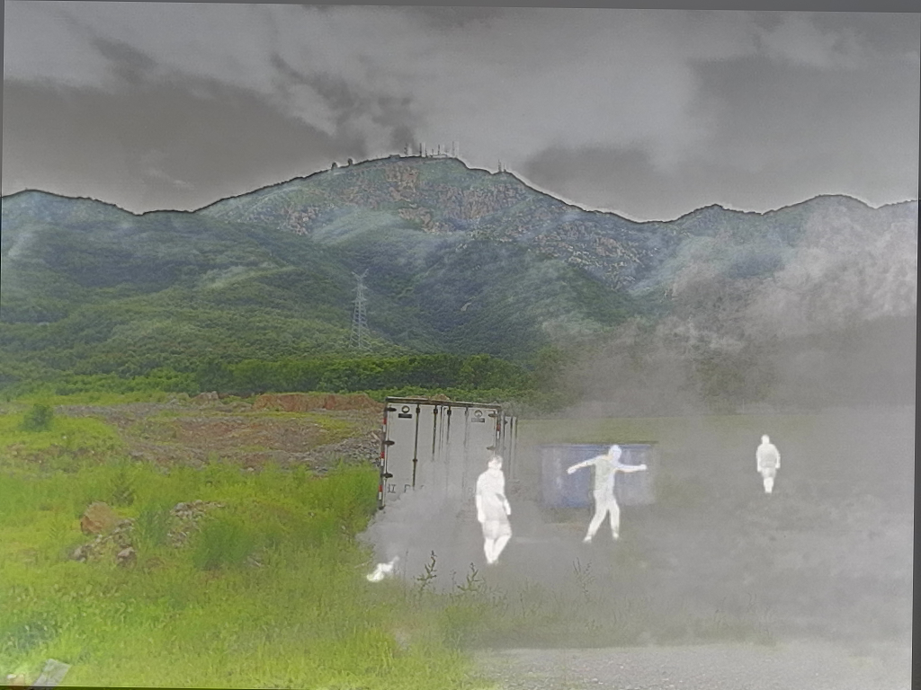

Slide 27
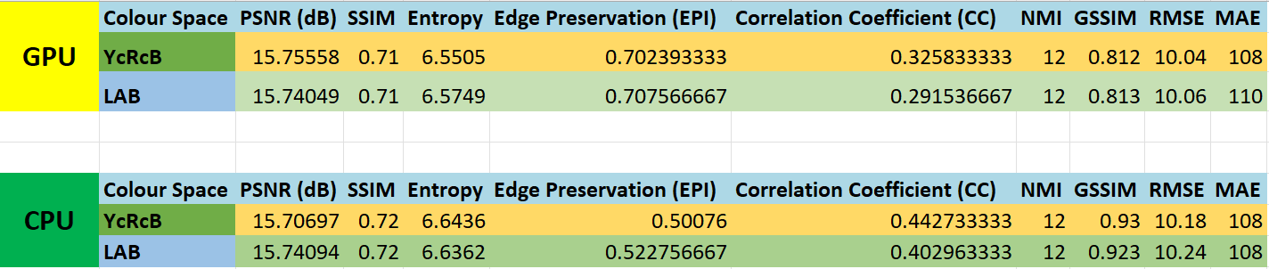
Performance Metrics For GPU and CPU

Slide 28
Contribution
Team Progress and Movement
Implementing image fusion algorithm
Data Preprocessing
Image Fusion Tests
Feature Extraction
Coding
Report Writing
Documentation
Individual Contribution
Key contributions: N.Shanmuka Harshavardhan Reddy
Preprocessing
Literature Review
Documentation
Visualization and Presentation
Key contributions: B.Thanuja
Experimental Setup
Testing Datasets
Result Analysis
Report Writing
Key contributions: S.Mohammad Khwaja Moinuddin
Testing Datasets
Coding
Paper Research
Feature Extraction

Slide 29
Conclusion & Future Work
Summary and Conclusion
In our project, we explored various color spaces such as YCbCr, LAB, and LCH and performed fusion using the Laplacian Pyramid (LP) fusion method to combine visible and infrared images. We conducted fusion experiments across different color spaces and tabulated the processing time for image fusion using both CUDA and CPU implementations. Additionally, we evaluated performance metrics, including PSNR, SSIM, and entropy, and displayed the average values for each color space.
Detailed measurements of computational time were conducted to assess the performance of the fusion algorithms. Strategies to optimize and improve computational efficiency were investigated to ensure the methods meet real-time processing requirements. This included fine-tuning algorithm parameters and exploring hardware acceleration techniques to enhance processing speed and overall system performance. These modifications have improved the quality and efficiency of the fused images, making them more suitable for real-time applications in areas like surveillance, medical imaging, and remote sensing.
Future Work
In future work, the implementation of the modified image fusion methods on the NVIDIA Jetson Nano platform will be explored to leverage its computational capabilities for real-time applications.

Slide 30
THANK YOU
Have a Great Day !

